Slide 1
Analysis of Model’s Inner Workings
Natural Language Processing
(based on revision of John Hewitt Lectures)

Slide 2
Announcement
TA announcements (if any)...

Slide 3
Researchers wear many hats (type of contributions)
Proof
Mathematicians: those who are very good in math and wants to prove/disprove that something really/does not really work
New / Improved Approaches
Engineers: those who always ponder how we can do things differently
Novel / Creative Applications
Practitioners: applying existing models in an interesting problem / unique applications
Analysis
Scientists: trying to understand why the model works and when will it not work; sometimes try to break stuff!
today!

Slide 4
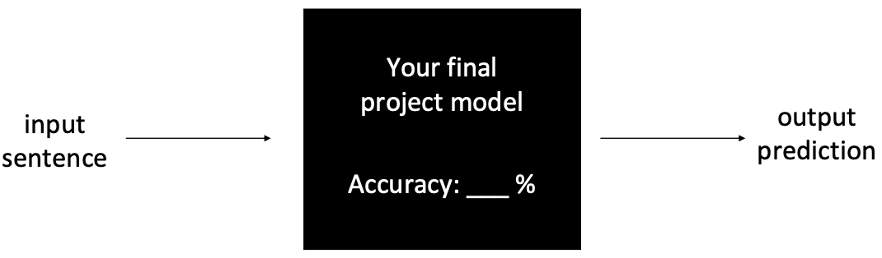
Using one single metric can be misleading

Slide 5
Analysis studies
Today we will take a glimpse (just 5% of what’s available!) at some analysis work, and hopefully, we can develop an intuition why analysis is important and how model are being inspected at high-level

Slide 6
Analyze by input

Slide 7
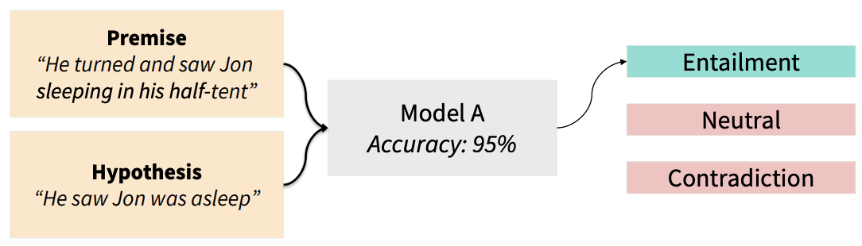
Diagnostic Test Set [McCoy et al., 2019]
Recall the natural language inference task, as encoded in the Multi-NLI dataset.
A Broad-Coverage Challenge Corpus for Sentence Understanding through Inference, Williams et al., 2018, https://cims.nyu.edu/~sbowman/multinli/paper.pdf

Slide 8
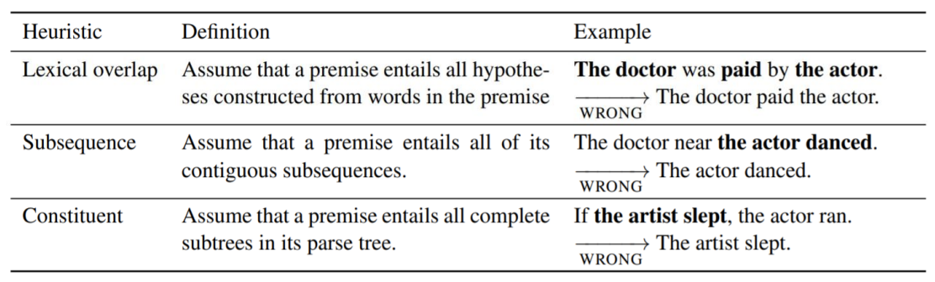
Diagnostic Test Set
McCoy et al., 2019 developed a diagnostic test set called HANs (Heuristic Analysis for NLI Systems) to analyze specific skill or capacity of the model

Slide 9
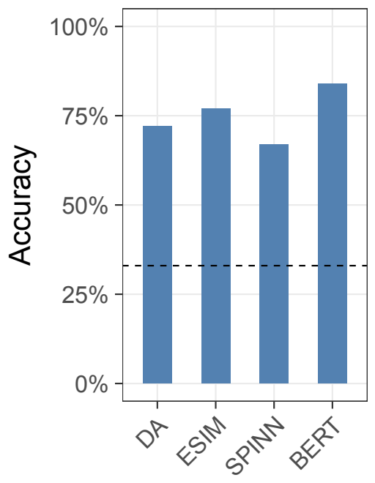
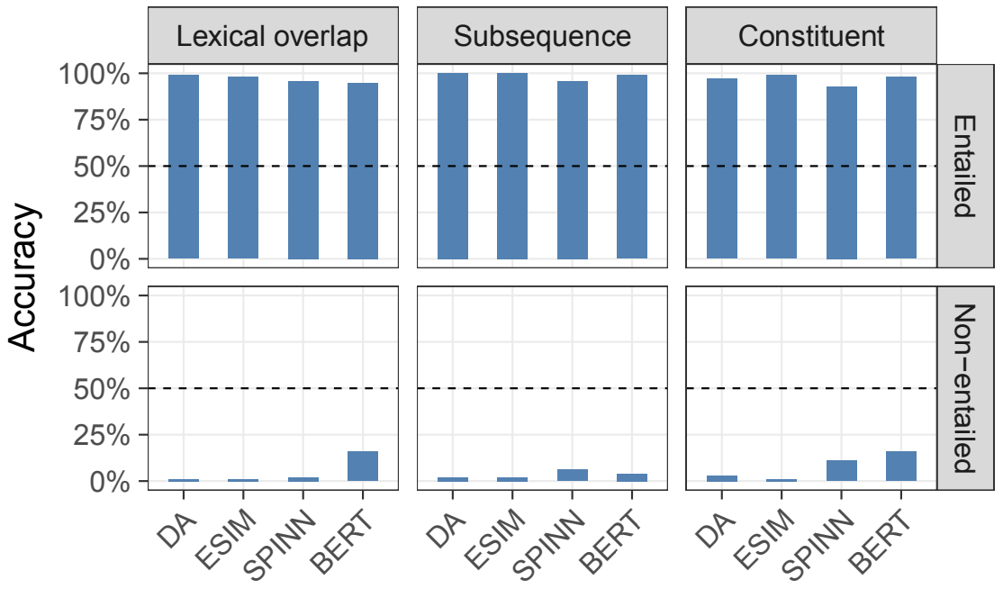
Diagnostic Test Set
McCoy et al., 2019 took 4 strong NLI models, with the following accuracies on the original test set (in-domain)
Evaluating on HANS, for the entailment conditions, accuracy is very high. But on the non-entailment conditions, accuracy is very very low.

Slide 10
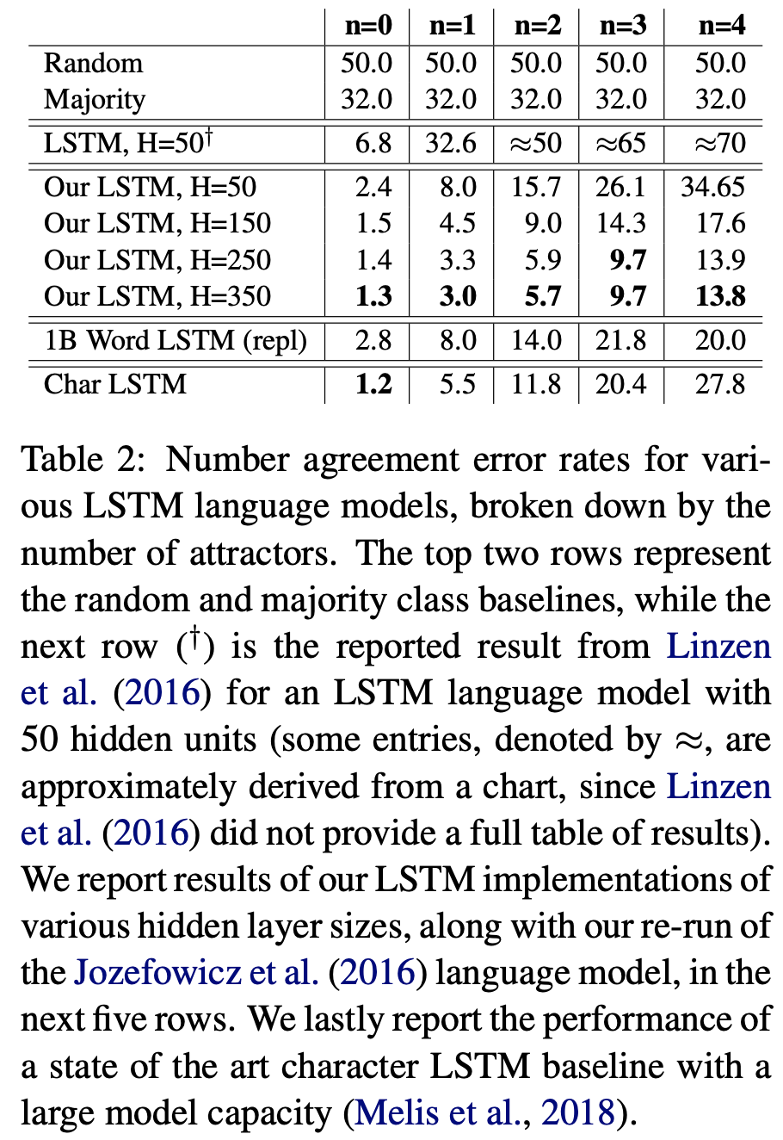
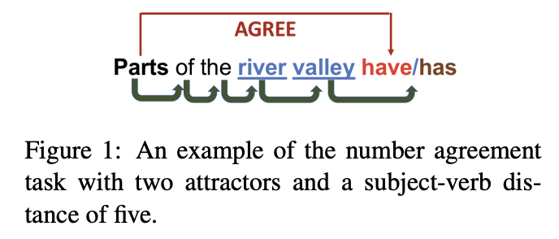
Syntax Sensitive Dependencies [Kuncoro et al., 2018]
LSTMs Can Learn Syntax-Sensitive Dependencies Well, But Modeling Structure Makes Them Better, Kuncoro et al., 2018, https://aclanthology.org/P18-1132.pdf

Slide 11
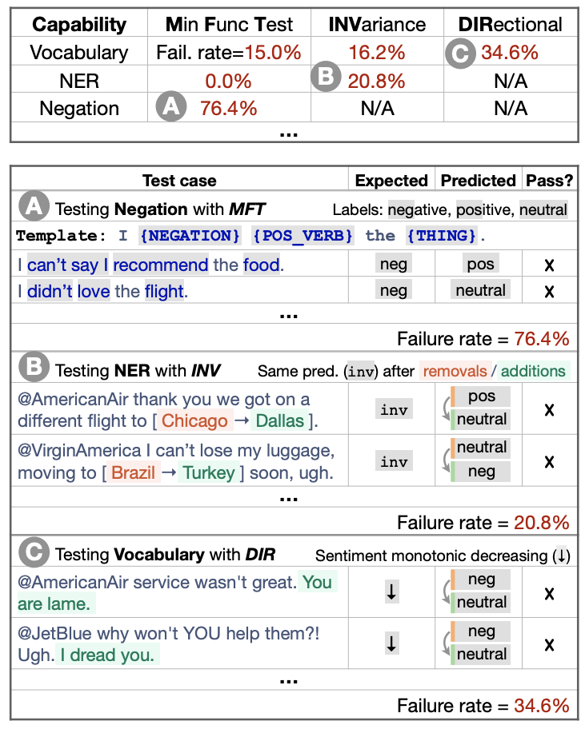
Unit Test Suites [Ribeiro et al., 2020]
Ribeiro et al., 2020 showed ML engineers working on a sentiment analysis product an interface with categories of linguistic capabilities and types of test.
They found a bunch of bugs using this method!
MFT - minimum functionality test
INV - invariance test
DIR - directional expectation test.
Beyond Accuracy: Behavioral Testing of NLP Models with CheckList, Ribeiro et al., 2020,https://arxiv.org/pdf/2005.04118.pdf

Slide 12
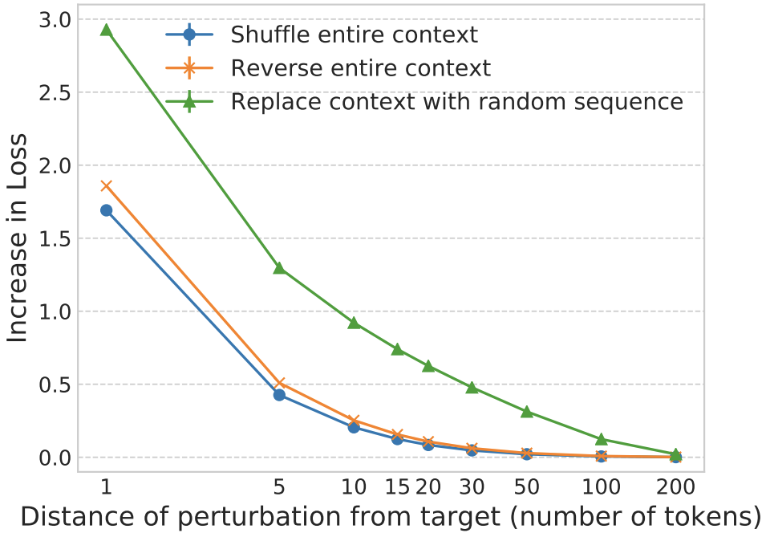
Does LSTM really use long-distance context? [Khandelwal et al., 2018]
shuffle or remove all contexts farther than 𝑘 words away for multiple values of 𝑘 and see at which 𝑘 the model’s predictions start to get worse!
Seems like history around 50 words apart is not as impactful
Sharp Nearby, Fuzzy Far Away: How Neural Language Models Use Context, Khandelwal et al., 2018,https://arxiv.org/pdf/1805.04623.pdf

Slide 13
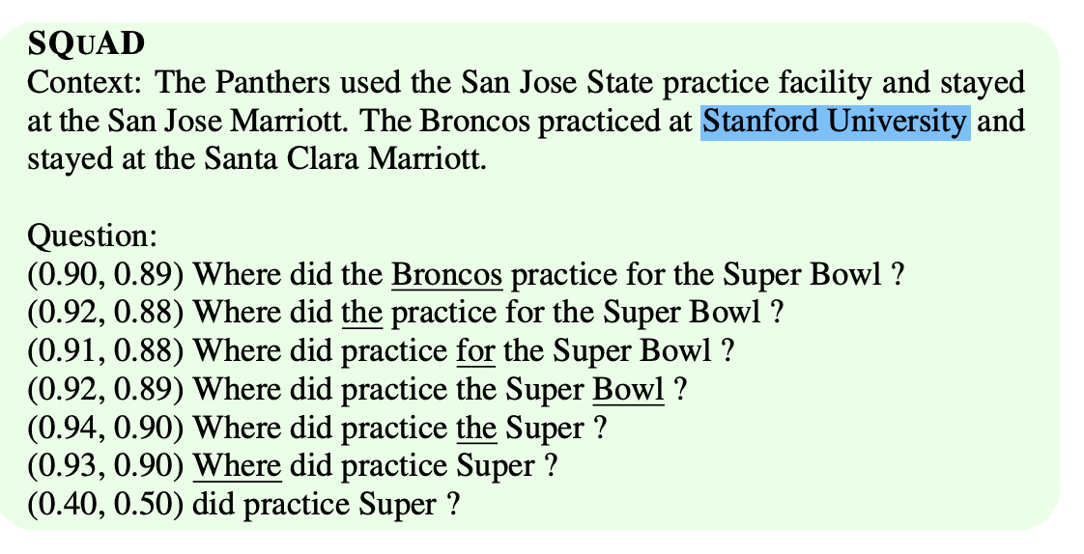
Will input reduction change the output? [Feng et al., 2018]
Iteratively remove the most unimportant words. Note that the parenthesis refers to (accuracy, confidence)
Pathologies of Neural Models Make Interpretations Difficult?, Feng et al., 2018, https://arxiv.org/pdf/1804.07781.pdf

Slide 14
Analyze by output

Slide 15
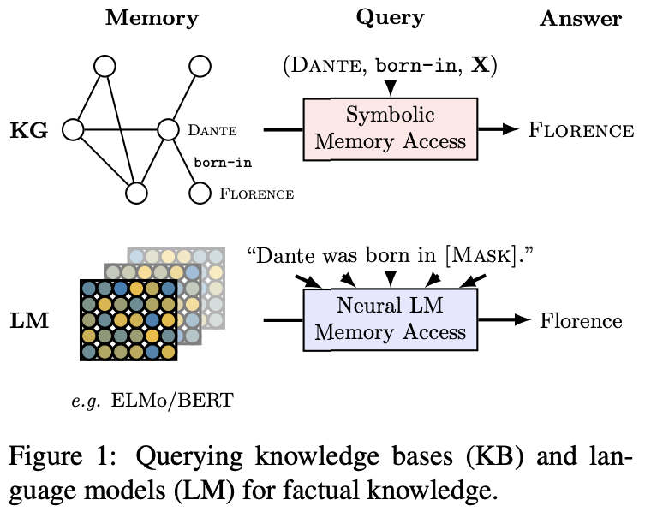
Knowledge Evaluation [Petroni et al., 2020]
How much does pretrained model retain knowledge?
Petroni et al., 2020 studies how well pretrained model answers some of NLP tasks questions
Amazed that without finetuning, BERT contains relational knowledge competitive with traditional NLP methods (oracle-based knowledge)
BERT also does remarkably well on open-domain question answering
Language Models as Knowledge Bases?, Petroni et al., 2020, https://arxiv.org/pdf/1909.01066.pdf

Slide 16
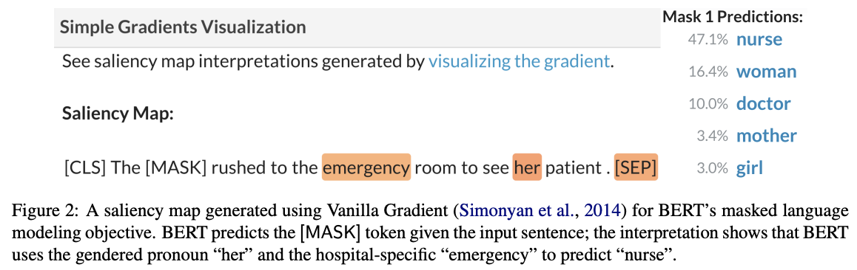
Saliency maps [Wallace et al., 2019]
Saliency maps explain a model’s prediction by identifying the importance of the input tokens. Gradient-based methods determine this importance using the gradient of the loss with respect to the tokens
AllenNLP Interpret: A Framework for Explaining Predictions of NLP Models, Wallace et al., 2019, https://arxiv.org/pdf/1909.09251.pdf

Slide 17
Analyze by noise

Slide 18
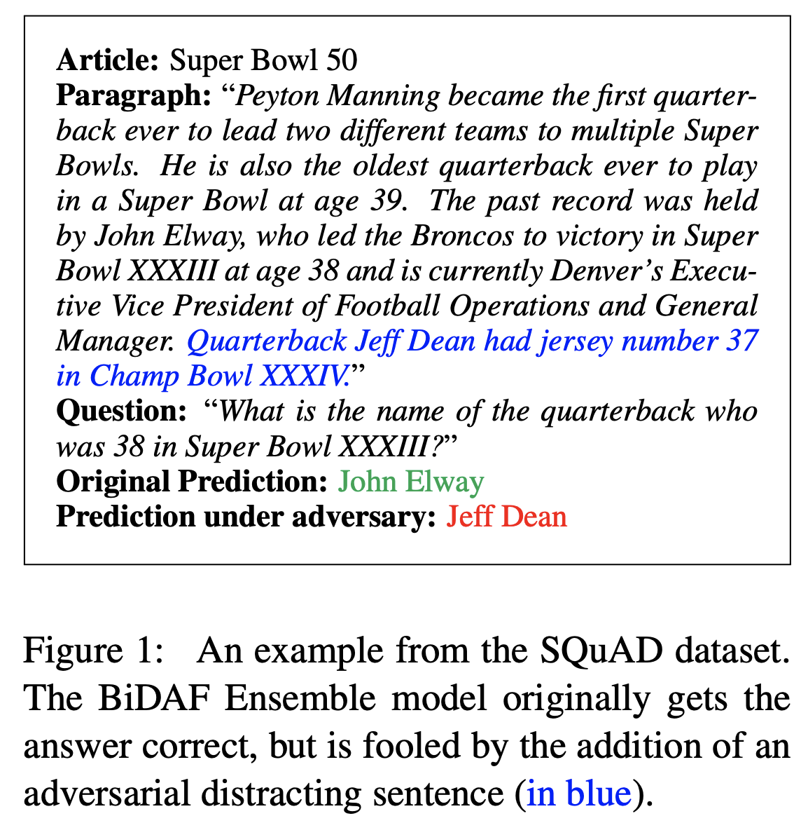
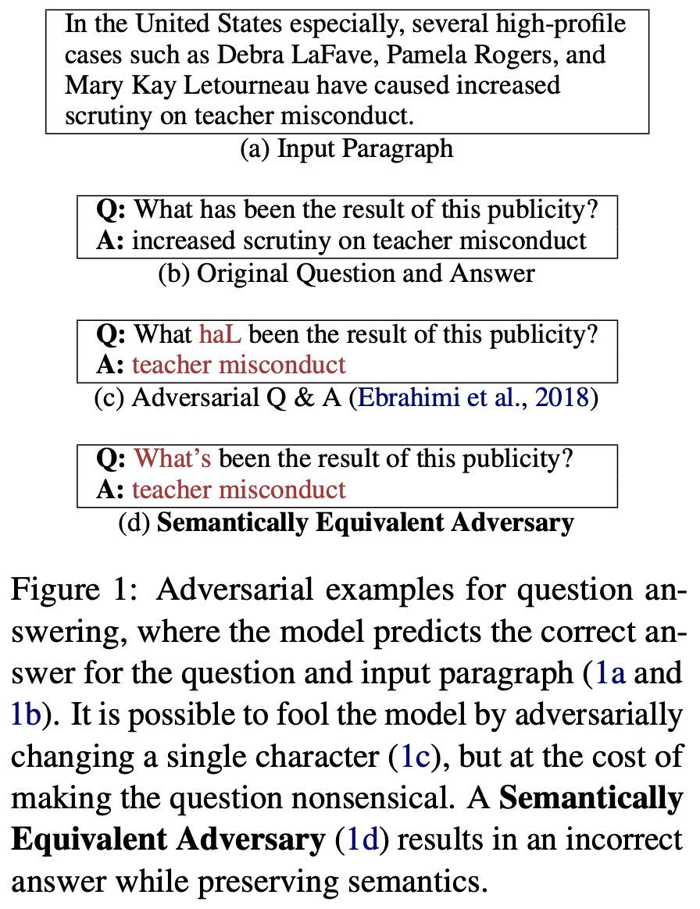
Adding noise breaks model [Jia et al., 2017, Ribeiro et al., 2018]
(left) Adversarial Examples for Evaluating Reading Comprehension Systems?, Jia et al., 2017, https://arxiv.org/pdf/1707.07328.pdf
(right) Semantically Equivalent Adversarial Rules for Debugging NLP Models, Ribeiro et al., 2018, https://aclanthology.org/P18-1079.pdf

Slide 19
Does swapping letters break model? [Belinkov and Bisk, 2018]
Can you read this?
“Aoccdrnig to a rscheearch at Cmabrigde Uinervtisy, it deosn’t mttaer in what order the ltteers in a word are, the only iprmoetnt thing is taht the frist and lsat letter be at the right pclae.”
Synthetic and natural noise both break neural machine translation, Belinkov and Bisk., 2018, https://arxiv.org/pdf/1711.02173.pdf

Slide 20
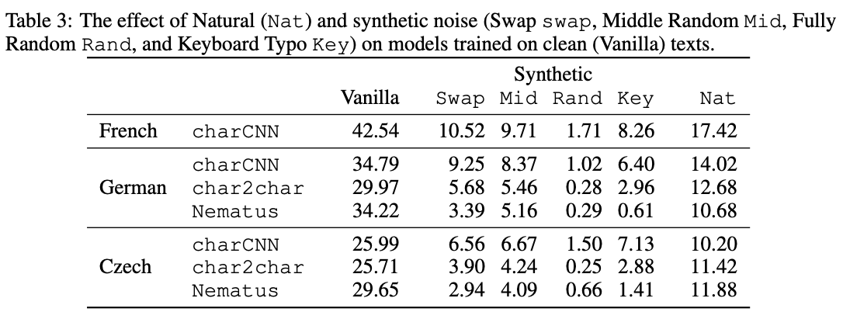
Does swapping letters break model?

Slide 21
Analyze by looking at inside the network

Slide 22
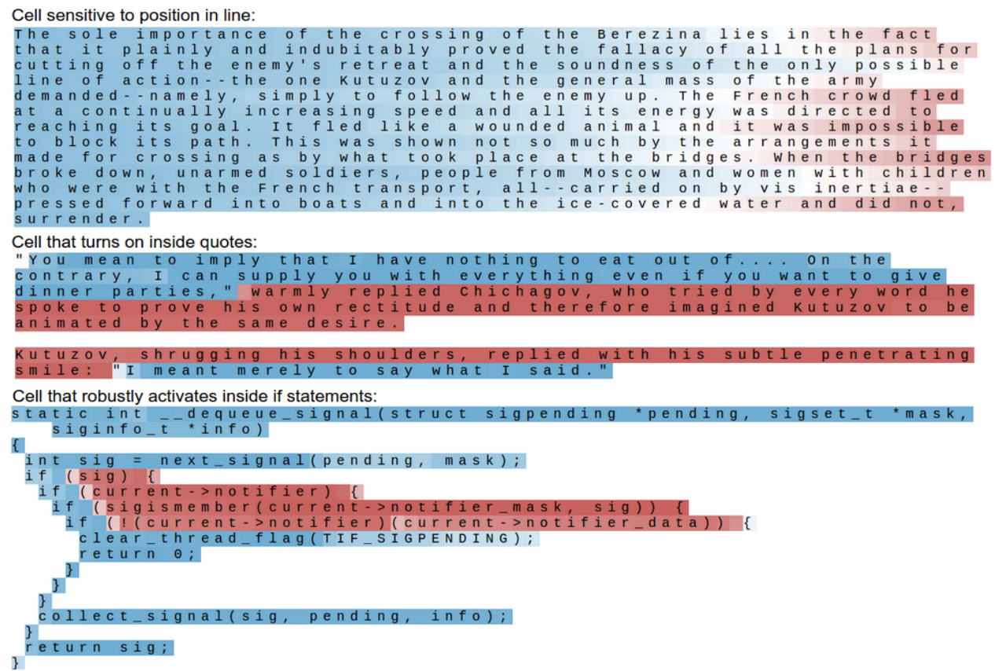
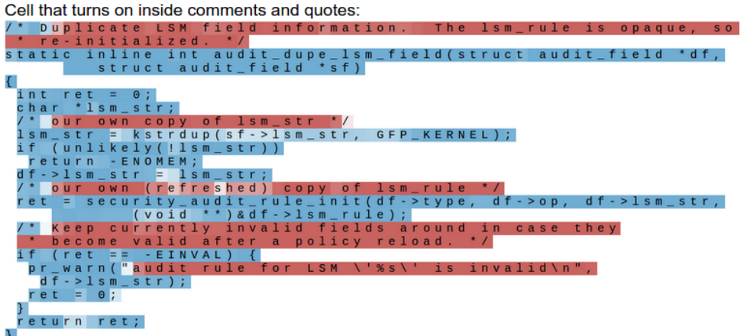
What does LSTM single cell attending to? [Karpathy et al., 2016]
Text color corresponds to tanh(c), where -1 is red and +1 is blue
Visualizing and understanding recurrent networks, Karpathy et al., 2016, https://arxiv.org/pdf/1506.02078.pdf

Slide 23
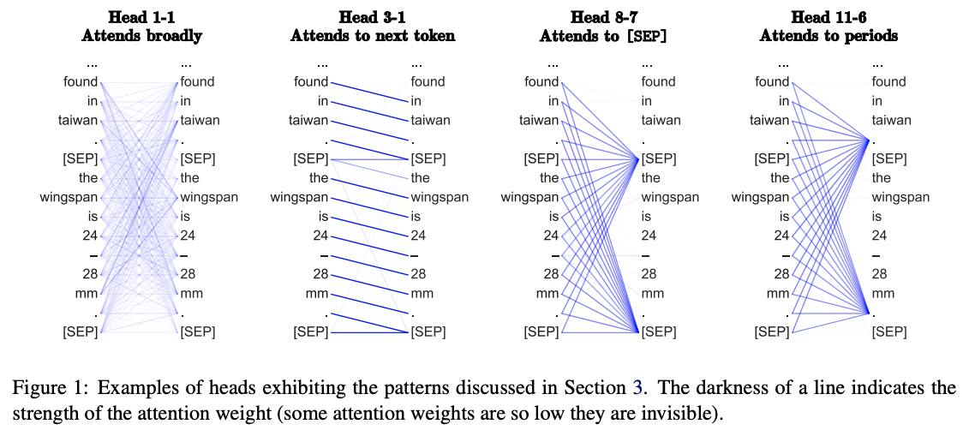
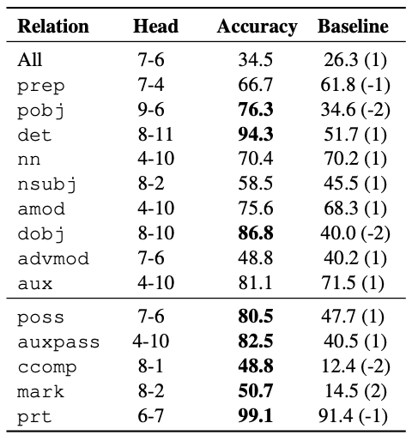
Does attention head really works? [Clark et al., 2019]
What does BERT look at? An analysis of BERT’s attention, Clark et al., 2019, https://arxiv.org/pdf/1906.04341.pdf

Slide 24
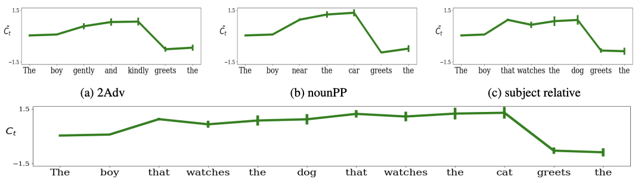
How LSTM handles subject-verb agreement? [Lakretz et al., 2019]
Y axis is the activation value. This is neuron 1150 in the LSTM, which seems to track the scope of the grammatical number of the subject! Removing this unit harms subject-verb agreement much more than removing a random unit.
The emergence of number and syntax units in LSTM language models, Lakretz et al., 2019,https://aclanthology.org/N19-1002.pdf

Slide 25
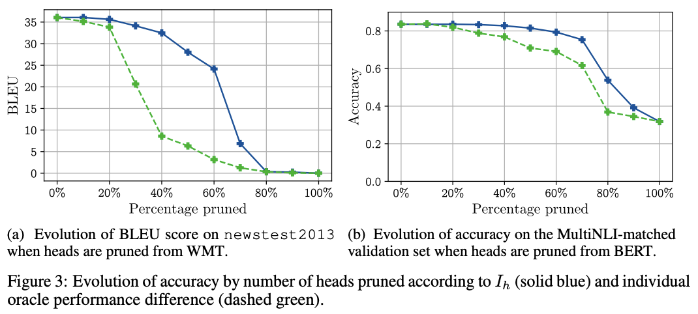
Do we need all these attention heads? [Michel et al., 2019]
Michel et al., 2019 train transformers with multi-headed attention on machine translation and natural language inference. After training, they find many attention heads can be removed with no drop in accuracy! (the green dashed line remove heads based on the least important first….)
Are sixteen heads really better than one, Michel et al., 2019, https://arxiv.org/pdf/1905.10650.pdf

Slide 26
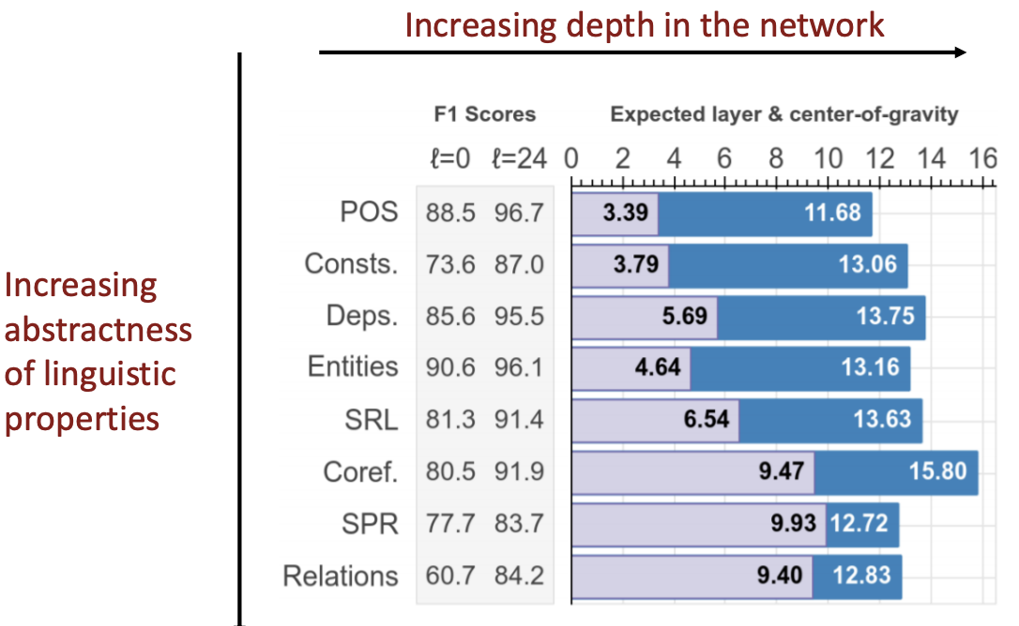
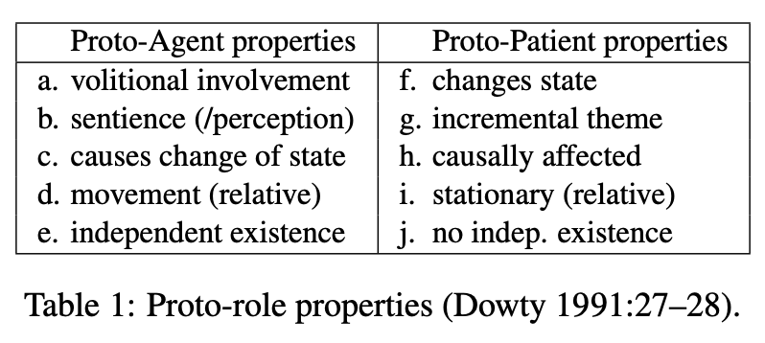
Layers vs. linguistic properties in BERT? [Tenney et al., 2019]
Increasingly abstract linguistic properties are more accessible later in the network.
The terms on the left: Part of Speech, Constituents, Dependencies, Entities, Semantic Role Labeling, Coreference, Semantic Proto-roles, Relations (SemEval).
BERT Rediscovers the Classical NLP Pipeline, Tenney et al., 2019, https://arxiv.org/pdf/1905.05950.pdf

Slide 27
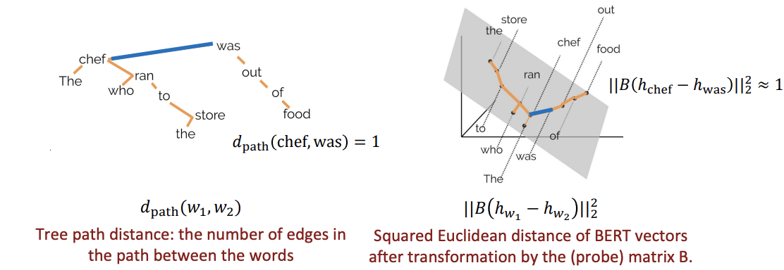
BERT and dependency parse trees [Hewitt and Manning, 2019]
Hewitt and Manning 2019 show that BERT models make dependency parse tree structure easily accessible.
A Structural Probe for Finding Syntax in Word Representations, Hewitt and Manning., 2019,https://nlp.stanford.edu/pubs/hewitt2019structural.pdf

Slide 28
Summary
All these deep learning stuffs are still not well understood
Encourage people to do more analysis
Also does not require huge computational power…
Analysis can be done on many abstractions - on the input, output, adding noise, on the layers, and even on the single neuron
High accuracy on the in-domain test set does not imply that the model will also perform well on out-of-domain examples
Model maybe simply learning the dataset, NOT the tasks
Using separate “hard” test set is very good way
Some trivias:
figures from most paper is very informative! Possibly the main contributions! Tables are good way for presentation!
You miss a lot by NOT reading papers!

